Slide 1
Les transformation en niveau de gris

Slide 2
Objectif de la séance
Que signifie « Améliorer une image » ?
Pourquoi améliorer une image ?
Comprendre quelque traitements en niveau de gris

Slide 3
Pourquoi améliorer une image?
Améliorer la qualité subjective de l’image :
Modifier les images pour facilité les traitement ultérieurs
Ne dépond pas de la position (x,y) du pixel mais plutôt de son niveau de gris !!!
Notes:
In the first case, the ultimate goal is an improved version of the original image, whose interpretation will be left to a human expert—for example, an enhanced X-ray image that will be used by a medical doctor to evaluate the possibility of a fractured bone
In the second scenario, the goal is to serve as an intermediate step toward an automated solution that will be able to derive the semantic contents of the image
—for example, by improving the contrast between characters and background on a page of text before it is examined by an OCR algorithm.
Sometimes these goals can be at odds with each other. For example, sharpening an image to allow inspection of additional fine-grained details is usually desired for human viewing, whereas blurring an image to reduce the amount of irrelevant information is often preferred in the preprocessing steps of a machine vision solution

Slide 4

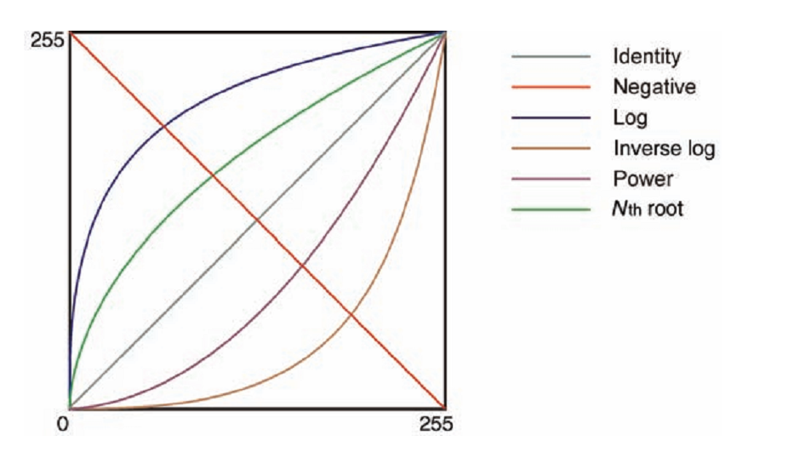
Résumé des transformation en niveau de gris
s
r
Notes:
Another way to put it is to say that image enhancement techniques are used when either :
(1) an image needs improvement,
or
(2) the low-level features must be detected [SS01]. Image enhancement methods “improve the detectability of important image details or objects by man or machine” [SS01]. This is different than attempting to restore a degraded image to its original (or ideal) condition, which is the scope of image restoration techniques

Slide 5
Exemples
Manipulation du contraste
Négatif
Transformations Gamma (Power Law)
Transformations logarithmiques
Transformations linéaire par partie

Slide 6
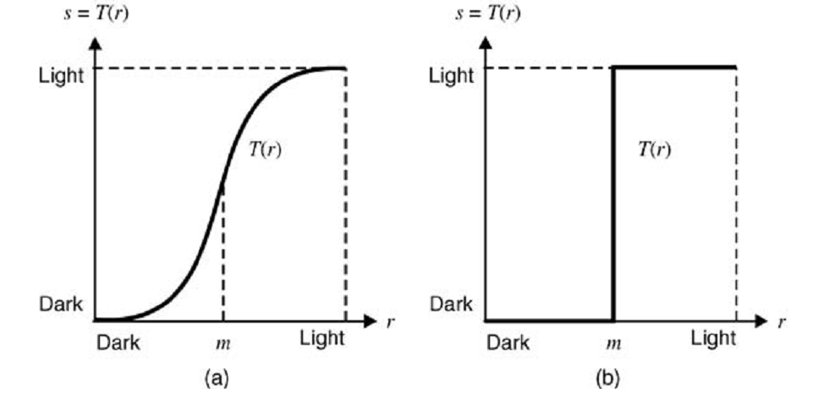
Manipulation du contraste

Slide 7
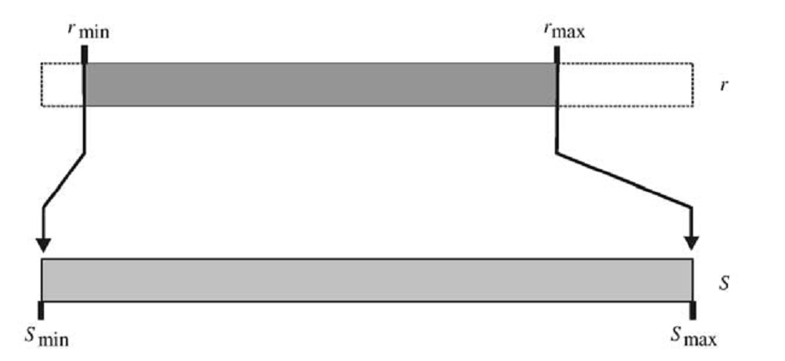

Manipulation du contraste (suite)
la fonction d’auto-contraste :

Slide 8
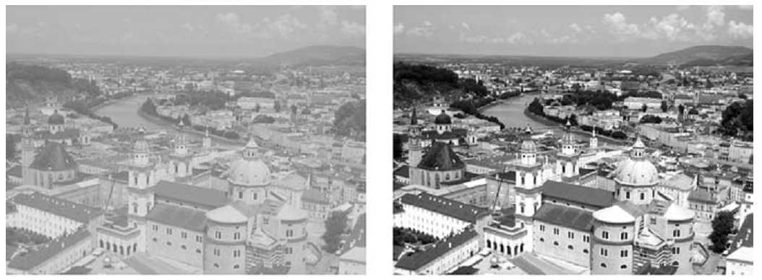
Manipulation du contraste (suite)
[ 90, 162]
[ 0, 255]

Slide 9
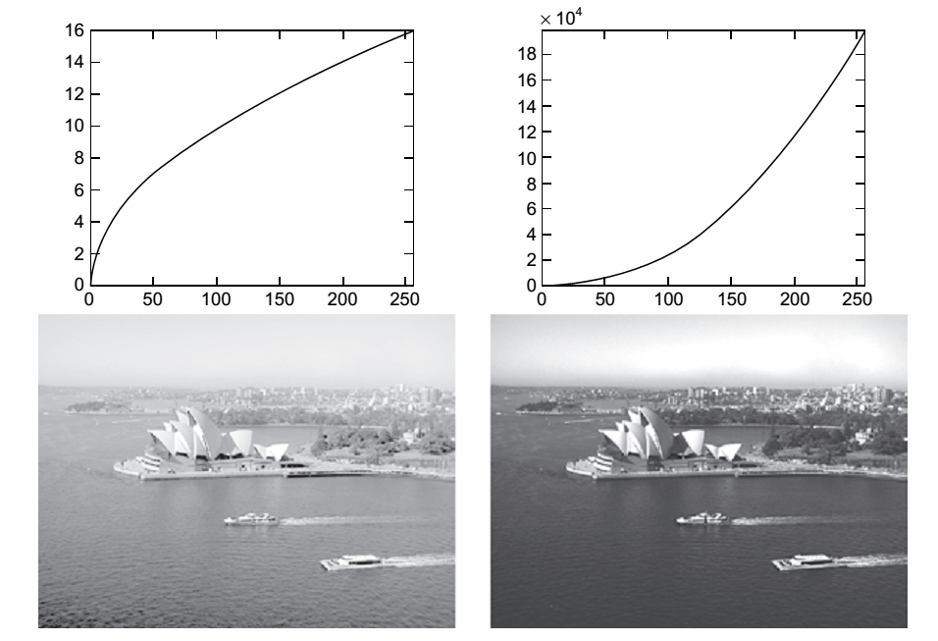


La correction Gamma

Slide 10

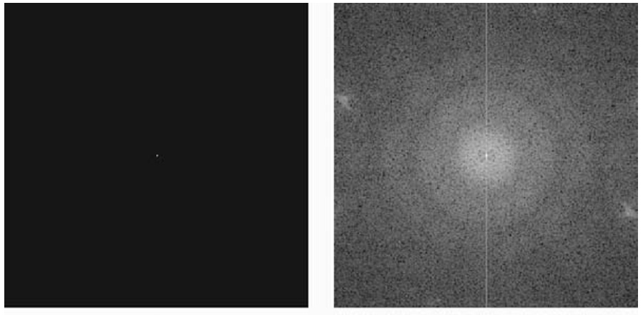
Transformations Log

Slide 11

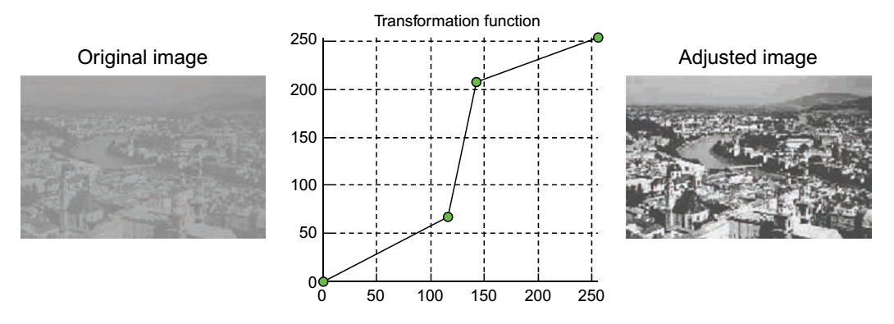
Transformations linéaires

Slide 12
Prochaine séance
Manipulation de l’histogramme

